Slide 1
Chapter 25 Introduction to Software Testing
Focus:
Principles of Testing and Unit Testing

Slide 2
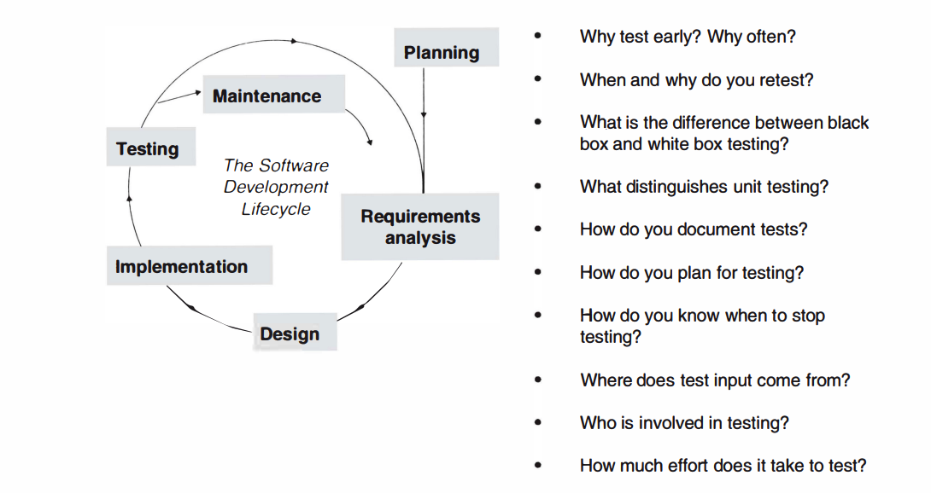

Slide 3
Software Testing Overview
Software testing is a validation process.
Purpose: Detect as many defects as possible, focusing on severity.
Key Insight: Testing reveals defects but cannot confirm their absence.

Slide 4
Why Test Early and Often?
'Test Early': Detect defects close to their introduction for easier correction.
'Test Often': Re-test after every addition or change to ensure integrity.

Slide 5
Agile Methodology Connection
Agile emphasizes continuous testing as part of development.
Goal: Avoid regression and ensure growth without erasure*.
* A goal of modern development methods, and especially of agile methods, is for the application under development to grow only-in other words, not to require any other kind of alteration such as erasures. Accomplishing this (which is not always easy) means that existing tests continue to apply as new elements are developed.

Slide 6
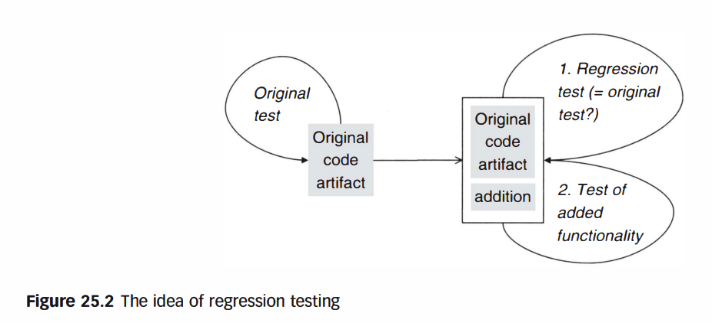
Regression Testing
Definition: Retesting software to confirm no new defects after changes.
Purpose: Ensure functionality remains intact after updates.

Slide 7
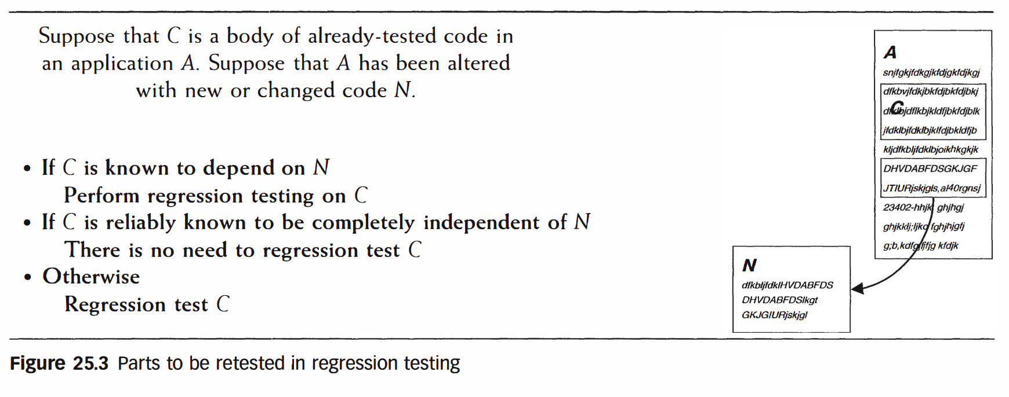
Regression Testing Example
Adding functionality to DVD rental software may alter due date handling.
Solution: Regression tests verify no unintended changes occurred.

Slide 8
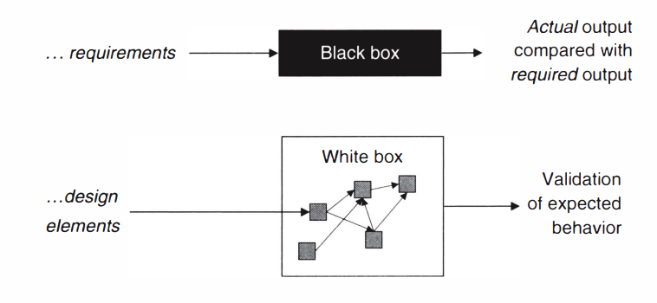
Testing Methodologies
Black Box Testing: Based on application requirements, no internal knowledge.
White Box Testing: Leverages design and implementation insights.

Slide 9
Unit Testing Overview
Definition: Testing individual components (methods, classes).
Goal: Detect defects early for cost-effective resolution.

Slide 10
Importance of Unit Testing
Defects undetected at the unit level can multiply in cost during later phases.
Example: Isolating defects early ensures foundational reliability.

Slide 11
Unit Testing and Modular Design
Object-oriented designs benefit from modular testing.
Classes and methods are natural units for isolated validation.

Slide 12
Interface Testing in Unit Testing
Validates the functions exposed by modules.
Ensures each module interacts correctly with its dependencies.

Slide 13
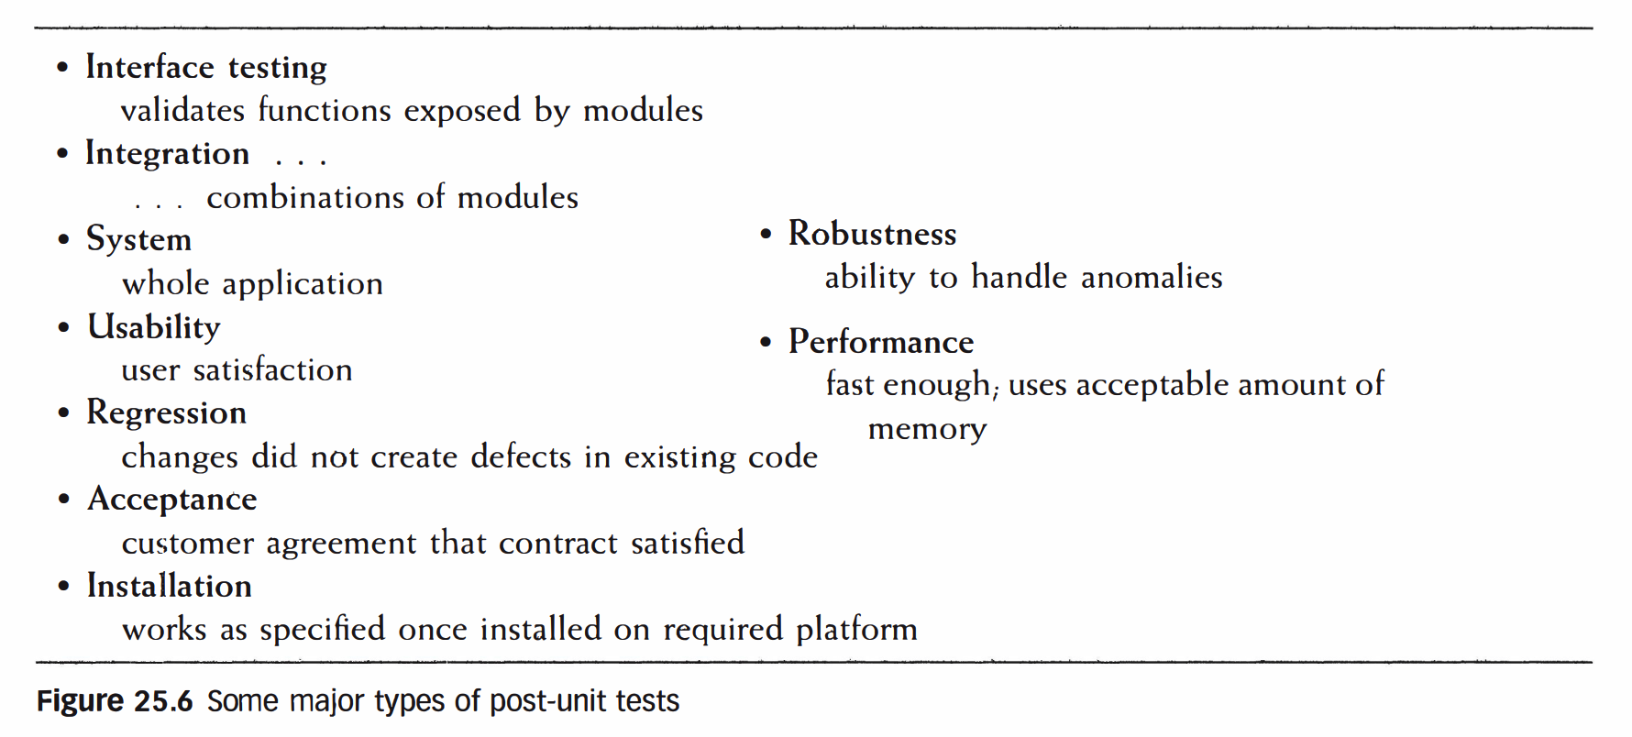
Post-Unit Testing Overview
Focuses on the integrated system beyond individual components.
Includes usability, performance, and regression testing.

Slide 14
Testing Objectives
Detect defects as early as possible.
Ensure each software component meets its intended purpose.

Slide 15
Documenting Tests
Maintain records of test procedures, input data, and results.
Reuse documentation for future testing cycles.

Slide 16
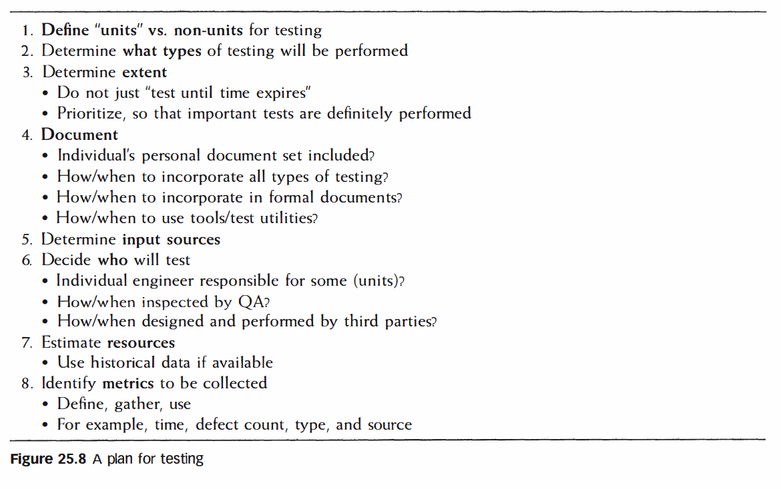
Planning Tests
Define test objectives and scope.
Prioritize critical functions for thorough validation.

Slide 17
Unit Test Execution
Leverage test utilities like Junit, PyUnit for consistent execution.
Automate repetitive tasks to improve efficiency.

Slide 18
Common Unit Testing Challenges
Overlooking edge cases.
Ensuring complete test coverage.

Slide 19
Test Input Sources
Domain-specific data examples.
Historical outputs from prior versions of the application.

Slide 20
Unit Testing Metrics
Metrics include defect count, defect types, and testing time.
Helps assess application state and forecast completion.

Slide 21
Summary of Principles
Test early, test often.
Unit testing ensures foundational reliability.
Effective planning and documentation are critical.

